Slide 1
Detecting Credit Card Fraud using Classification Models
Prerna Roy (Riya)
Machine Learning Project

Slide 2

Background
Credit card fraud happens when an unauthorised individual gains access to an individual's credit card information in order to make fraudulent purchases and transactions.
It is clear that financial institutions need to create highly accurate systems/models in order to prevent credit card fraud and protect their customer base financial information.
As cybercrimes grow more sophisticated, banks and other financial institutions will need to improve their ability to classify fraudulent transactions from real ones.
Credit card fraud often happens when a card is lost or stolen, or through phishing and scamming schemes. It can even happen through hacking, or through malicious websites.

Slide 3
Business Value
01
Protect credit card holders in the event their credit card details becomes compromised.
Prevent potential huge financial loss for credit card holders should fraudulent transactions be made.
Credit card holders
02
Give banks and other financial institutions an accurate method to flag fraudulent transactions before they can fully occur.
Help banks identify different forms of credit card fraud.
Financial institutions
03
Protect merchants and businesses who may have received fraudulent payments as a result of credit card fraud.
Merchants and businesses

Slide 4
Aim
The aim of this project is:
To create a model that can accurately classify whether a transaction is real or fraudulent from a given synthetic dataset of transactions.
To apply this model to the original, highly-imbalanced dataset of transactions made by European cardholders in September 2013.
Transaction Data
Classification Model
Real transaction (0)
Fraudulent transaction (1)

Slide 5
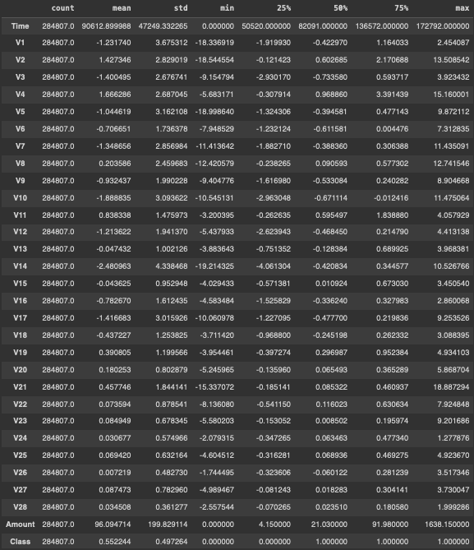
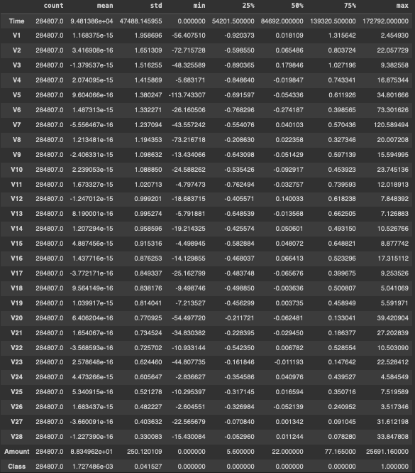
Datasets
Synthetic dataset (to build model):
284,807 rows, 31 columns
30 variables (independent)
1 dependent variable
Original dataset (to test generalisability of model to real data):
284,807 rows, 31 columns
30 variables (same as synthetic)
1 dependent variable
Synthetic
Original
Notes:
Create model using synthetic dataset
Use real dataset on model
Check precision/recall/f1 score

Slide 6
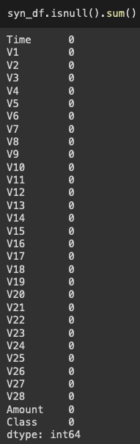
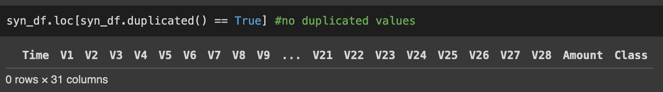
Synthetic Dataset Variables
Time | Seconds elapsed between each transaction and the first transaction in the dataset.
Amount | Amount of the transaction.
V1 - V28 | Principal components obtained using PCA, masked for confidentiality purposes.
Class | Response variable indicating fraudulent transaction (1) or real transaction (0).
Note: The real dataset contains the same variables as the synthetic one.

Slide 7
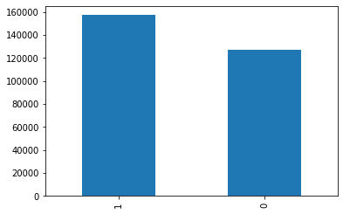
Class distribution of data
Classes:
1 = Fraudulent transaction
0 = Real transaction
This dataset was made synthetically to improve the balance of data from the original dataset, which only contained 492 fraudulent transactions out of 284,807 total transactions.

Slide 8
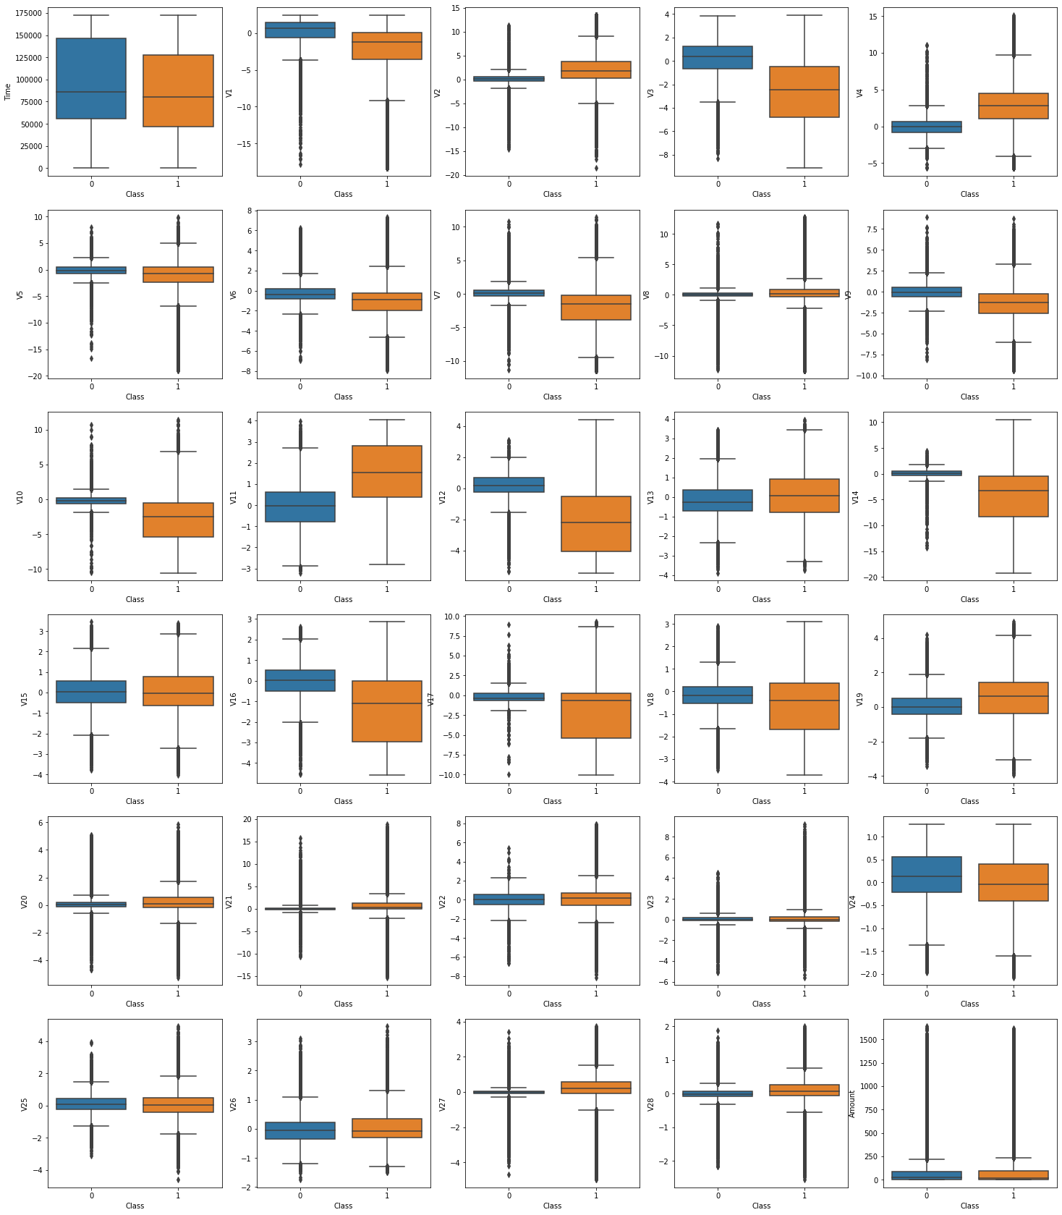
Exploratory Data Analysis: The distributions of each independent (X) variable.
Almost all of the variables (apart from Time) contain significant outliers).
Some of the variables’ distributions have high skewness.
The means/IQRs of some variables overlap more between the two classes and vice versa.
Feature scaling is likely needed due to the hugely different range in values for each variable.

Slide 9
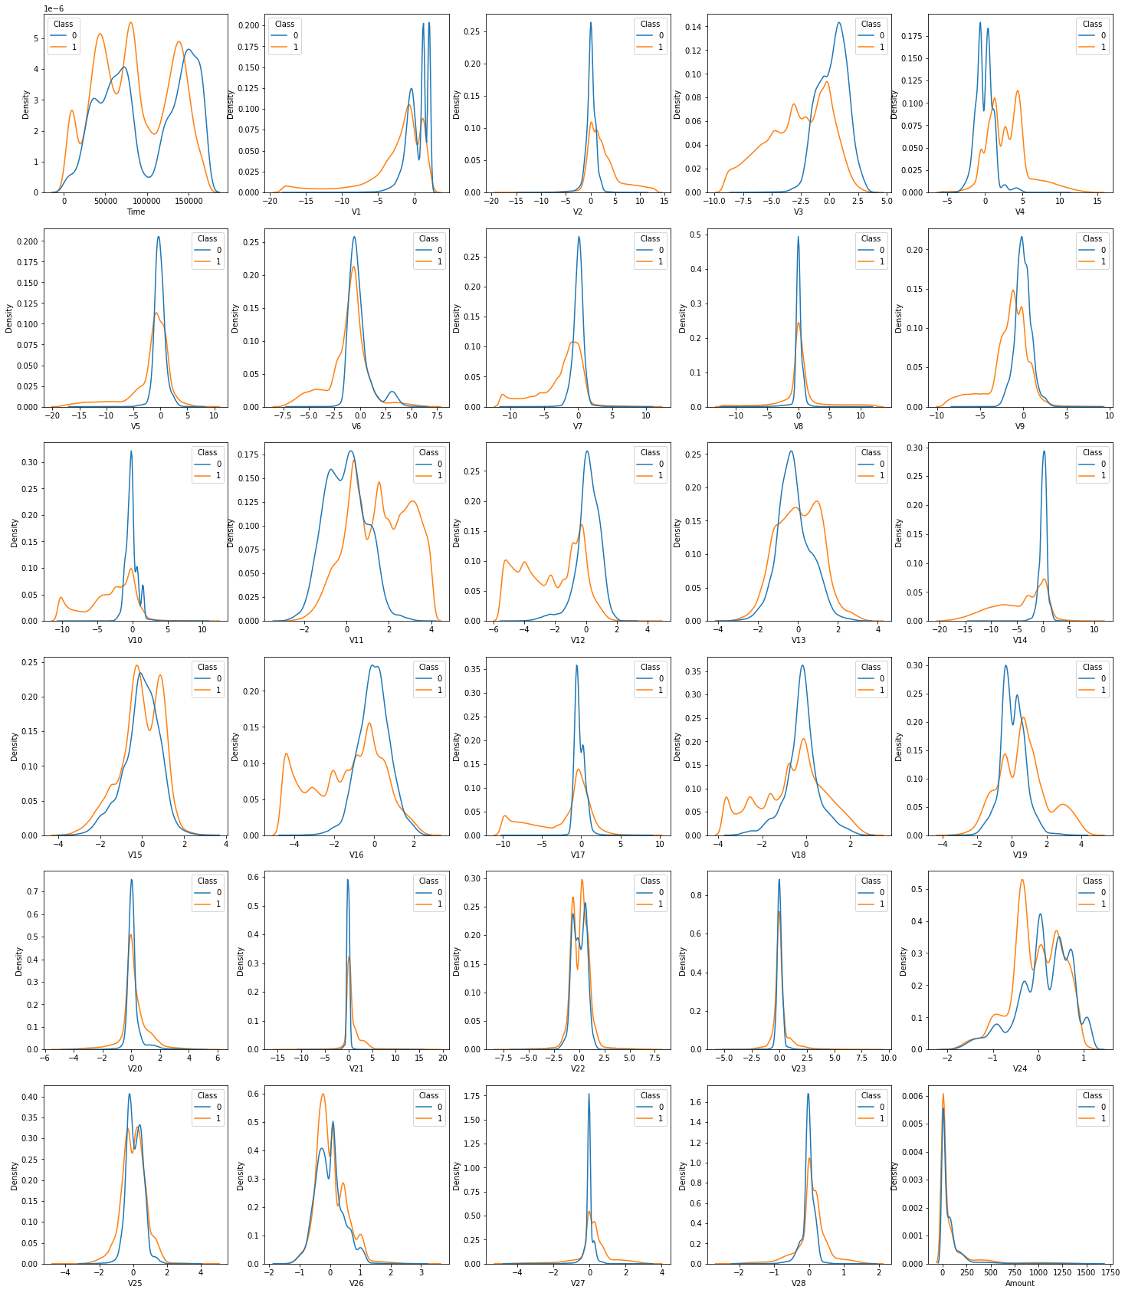
Exploratory Data Analysis: The distributions of each independent (X) variable
Many of the distributions are non-Gaussian, especially for the fraudulent classes.
Additionally, it can be observed that some distributions have high separability between the two classes.
Other variables have their distributions for each class overlap significantly.

Slide 10
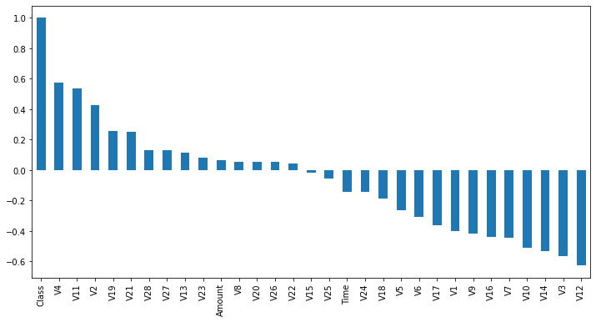
Correlation between class and variables
EDA: Correlation between Class and variables. The highly separable variables are less correlated to fraudulent transactions and vice versa. This could be potentially important in assessing how much a single variable is useful in separating the two classes (e.g. in clustering).

Slide 11
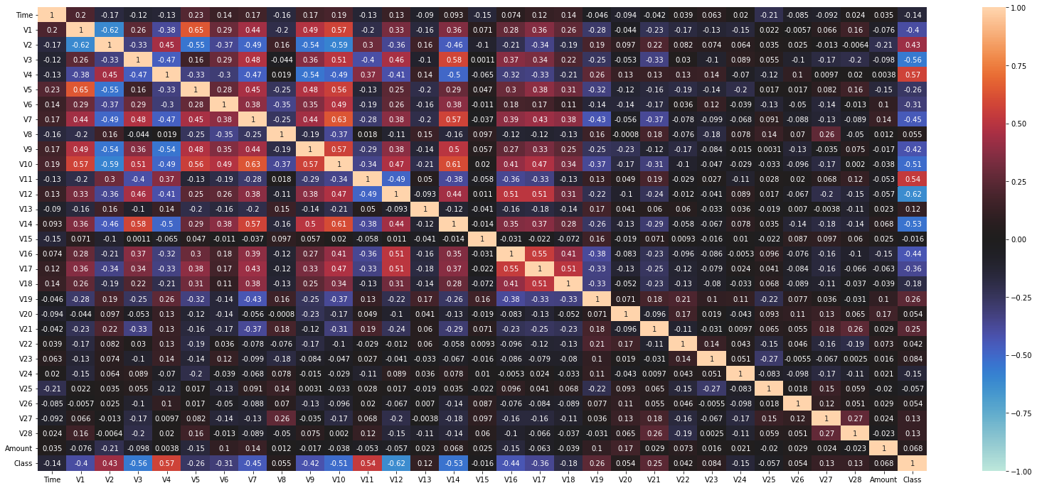
EDA: Correlation heatmap. Re-confirms the variables that are positively and negatively correlated to the fraudulent classes.

Slide 12
Data Preprocessing & Cleaning
Not much data cleaning required; no null values and no duplicates.
Class column was changed to ‘object’ for visualisation purposes, and ‘int’ for correlation analysis and model training.
All features (excluding Class) were scaled using Standard Scalar, as their distribution range was very large in range (e.g. time/amount was much larger than any of the V(x) variables).

Slide 13
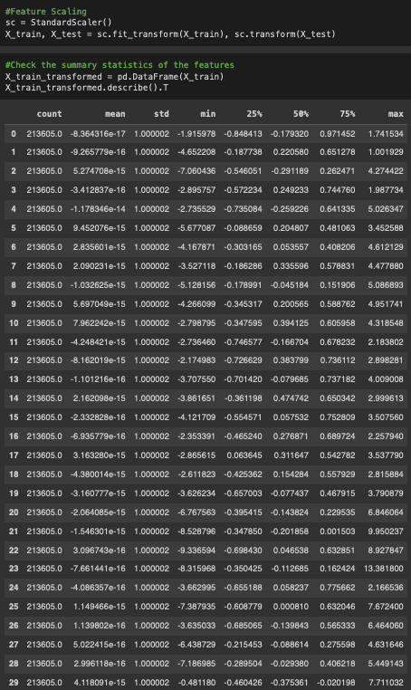
Feature Scaling - Standard Scalar
Train-test split of 0.75 to 0.25, respectively.
The X training and testing groups undergo feature scaling using standard scalar.
After this transformation, it can be seen that the mean is very close to 0 for each variable, and the standard deviation is close to 1.
This is done to make training faster, as the original values had a huge range across the variables.

Slide 14
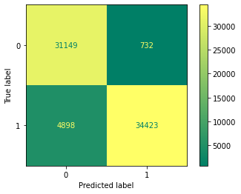
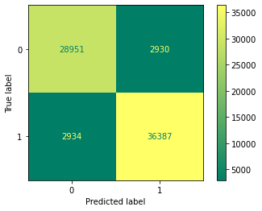
Models Tested
KNN (default parameters):
Accuracy: 92.1%
Precision: 98.0%
Recall: 87.5%
Decision Tree (default parameters, random_state=42):
Accuracy: 92.0%
Precision: 93.0%
Recall: 93.0%

Slide 15
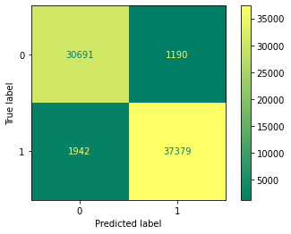

Models Tested
Random Forest (n_estimators = 200, random_state=42):
Accuracy: 95.6%
Precision: 97%
Recall: 95%
XGBoost (n_estimators = 500, random_state=42):
Accuracy: 96.5%
Precision: 97.5%
Recall: 96.1%

Slide 16
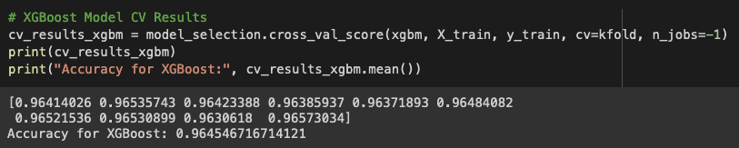
Cross-validation Performance of XGBoost
The best performing model was XGBoost. To determine if the model was truly performing well, k-folds cross-validation was used with 10 splits. The results were as follows, demonstrating consistently good performance:

Slide 17
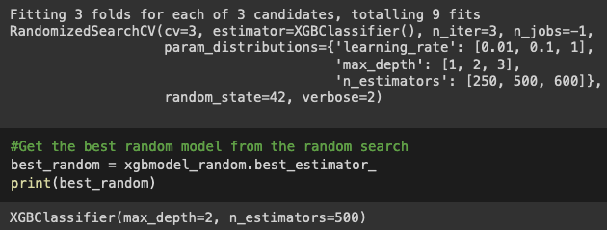
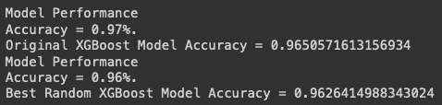
Random Search Hyperparameter Optimisation
RandomizedSearchCV was used in order to attempt finding a set of hyperparameters that could potentially produce even better accuracy overall. However, the results of the random search produced a set of hyperparameters that were similar in performance to the original. The original was used instead.
Note: not many hyperparameters could be optimised due to computational limitations. Given the huge size of the dataset, the optimisation section can take several hours and there are limitations on RAM/CPU usage from CoLab.

Slide 18
Testing the original dataset

Slide 19
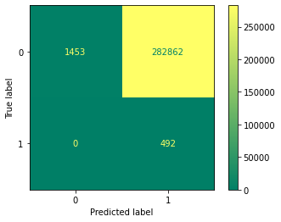
Results of using XGBoost Model on original data
Same steps were taken to prepare X and y (including feature scaling).
Accuracy: 68.3%
Precision: 0.0017%
Recall: 100%
Does not perform well as it has a very high false positive rate.
*There are only 492 fraudulent transactions in the original dataset, which were all classified as fraudulent, hence recall = 100%.

Slide 20
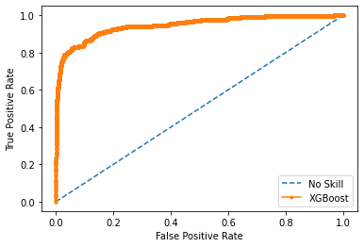
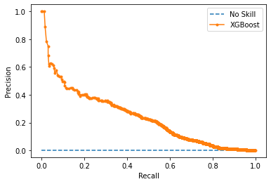
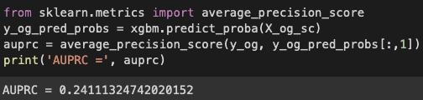
AU-ROC and AU-PRC Curves
AUC-ROC is misleading in this instance - model is not performing well at identifying real transactions as real. AU-PRC is more accurate with a AU-PRC value of 0.24, as it focuses on the minority class. AUPRC is better used for imbalanced datasets for this reason.

Slide 21
Conclusions
XGBoost is a good model for this classification problem and performs faster than its closest-in-performance counterpart, Random Forest.
XGBoost performs very well on the original dataset, as there is a more even spread of the two classes. There could potentially be overfitting to this dataset.
The highly imbalanced original dataset is not well classified by the XGBoost model, and has a very high false positive rate.
The performance of this model can be improved, potentially through better hyperparameter optimisation.

Slide 22
Limitations
Computational limitations:
Training and testing the models took quite a long time due to computational limitations and the huge dataset sizes.
This required opting for less complex hyperparameters at the cost of higher accuracy, particularly when doing hyperparameter optimisation.
Unable to generalise to original fraudulent transaction dataset well:
Whilst recall was 100% for the fraudulent transactions, the false positive rate is extremely high. This is unacceptable in the use case for a bank/financial institution as customers would frequently be wrongly alerted of normal transactions.
Unknown variables:
Masked variables limit the amount of exploratory data analysis that could be conducted on the entire dataset - potentially missing out useful information or engineered features to improve performance or selection of independent variables for model building.

Slide 23
Future Work
Use cloud computational resources to improve hyperparameter optimisation.
Trial more hyperparameters to optimise for.
Use/incorporate original dataset with synthetic dataset to create model.
Use techniques to handle imbalance datasets, such as SMOTE/SMOTEENN and create models using the original dataset instead.
Use pipeline method to build models instead of creating them individually to improve efficiency of model testing.

Slide 24
Q&A
Thank you for listening!

